Slide 1
Introduction to R
Yunkang Yang
Department of Communication Center for Social Science Computation and Research
University of Washington
2018

Slide 2
Class Outline
What is R?
Why use R?
The R Environment
R studio
Setting up the working directory
Reading in Data
Viewing and manipulating Data

Slide 3
What is R?
While many people use R for statistical analysis, R is actually a full programming environment.

Slide 4
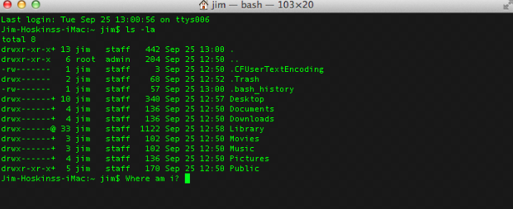
R is completely command-driven.

Slide 5
Because R is a programming environment, people use it to do many things:
--Statistical analysis
--Data manipulation (to get ready for analysis)
--Graphics
--Simulation
--Interactive web applications (using Shiny)

Slide 6
Why use R
Free and open source
No license restrictions
4800 packages for specialized topics (e.g. “dplr” for data manipulation, “sns” for social network analysis, “twitterR” for scraping tweets, etc.)
Runs on many operating systems
Excellent graphics
Active user groups

Slide 7
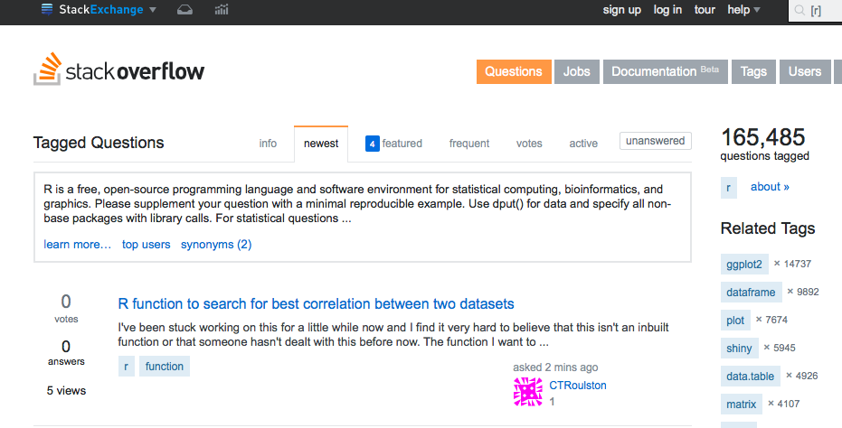

Slide 8
Downloading R
Windows(32/64 bits)
https://cran.r-project.org/bin/windows/base/
Mac
https://cran.r-project.org/bin/macosx/
Downloading R studio
www.rstudio.com/products/rstudio/download

Slide 9
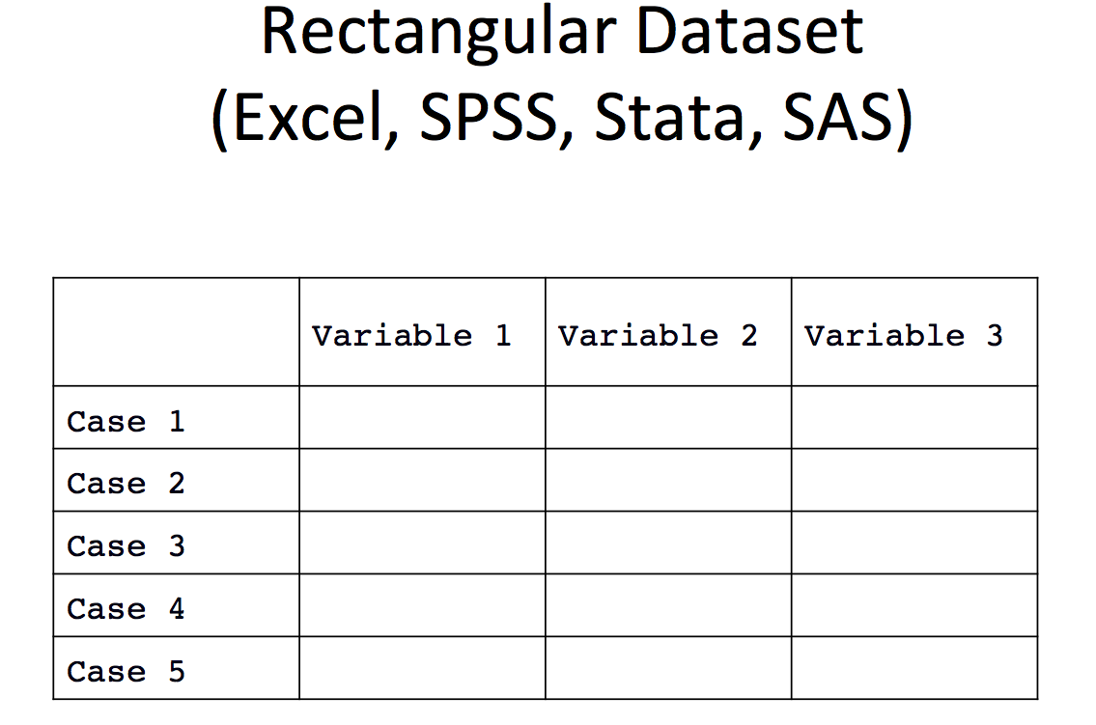
The R Environment
A traditional stats program like SPSS or Stata only contains one rectangular dataset at a time. All analysis is done on the current dataset.

Slide 10
The R Environment
R contains different objects.
They can be data or methods you run on the data.
Objects (e.g. data frames, vectors, matrix, functions, etc.)must have names for you to work with them.

Slide 11
R is also function-driven.
The functions (e.g. addition, multiplication, average, standard error, etc.) act on objects and return objects.
Functions themselves are objects too!
Input
Function
Output
Notes:
Mulplication, addition, subtraction, and build more complex function

Slide 12
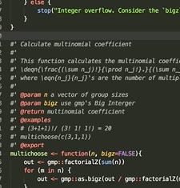

You may want to keep your code in a separate file with the extension “.r”

Slide 13

You may want to keep your code in a separate file with the extension “.r”
The code is different from the objects (data) in your environment. It is just commands that manipulate the objects.

Slide 14
Why use R studio?
Easy to use
Datasets readily available for viewing
Variable names at your fingertips
Multiple windows for comprehensive view
Notes:
integrated development environment (IDE) for R

Slide 15

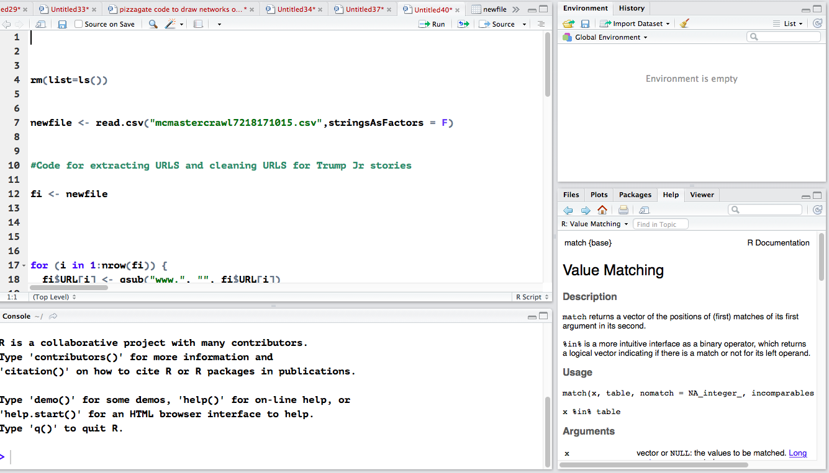
Notes:
The console – where you can type commands and see output
environment and history
The workspace tab stores any object, value, function or anything you create during your R session.
The history tab keeps a record of all previous commands
Files plots..
R srcirpts and data view

Slide 16
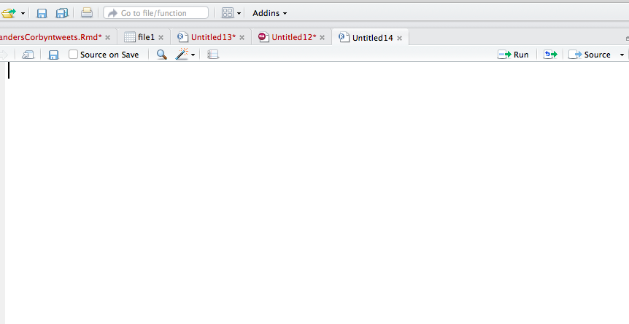
R studio
R script: Upper left hand corner of R studio screen
Store all your commands in script

Slide 17
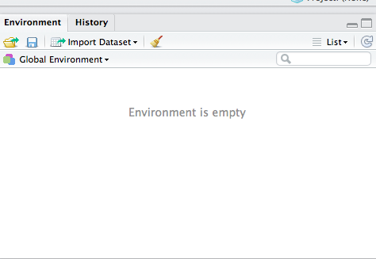
R studio
Upper right hand corner of R studio screen
Shows all the datasets that have been imported and created through dataset transformations

Slide 18
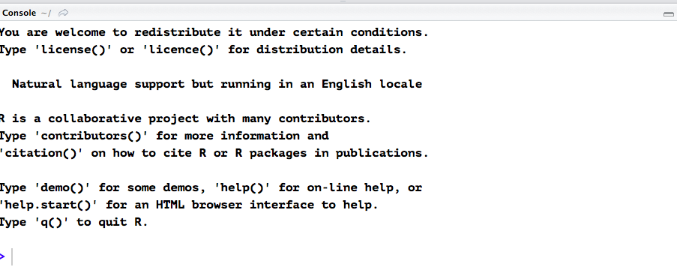
R studio
R console: Lower left hand corner
Runs your commands (Press enter)

Slide 19
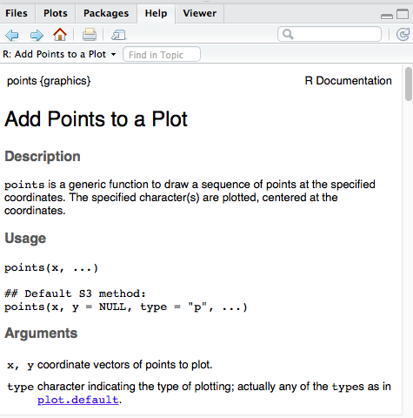
R studio
Home: Lower right hand corner
List of files you will have in your working directory
Plots
Packages

Slide 20
Setting up your working directory
R is always pointed at a directory on your computer.
getwd()
# Set the working directory setwd("C:/Documents and Settings/Data")
Notes:
write.csv(mtcars,”C:/temp/cars.csv”)

Slide 21
Reading in Data
read.csv
read.table(filename, …)
cars <- read.csv(“C:/temp/cars.csv”)

Slide 22
Help function
Help(function name)
R is case-sensitive
Try: ?read.csv

Slide 23
Help function
One help file may contain information for several functions.
Usage: Shows syntax for command and required arguments(input) and any default values for arguments
Value: the output object of the function

Slide 24
Viewing data
What does the dataset (e.g. data frame) look like?
How many observations does it have?
How many variables does it have?
What are the names of the variables?
library(datasets)
mtcars
?mtcars
str(mtcars)
colnames(mtcars)
dim(mtcars)
nrow(mtcars)
ncol(mtcars)

Slide 25
How to index
What if I only want to view the third observation?
mtcars[3,]
What if I want to view the third variable?
mtcars[,3]
Notes:
Display all columns for row 3
Display all rows for column 3

Slide 26
mtcars[1,4]
Shows the value at row 1 column 4
mtcars[3:9,7]
Shows rows 3-9 column 7

Slide 27
mtcars$mpg
Notes:
You can also access columns (variables) using the “$” symbol if the data frame has column names:

Slide 28
Analyzing data
summary(mtcars)
table(mtcars$gear)
hist(mtcars$qsec)
mean(mtcars$mpg)
sd(mtcars$mpg)
cor(mtcars$mpg, mtcars$wt)
plot(mtcars$mpg, mtcars$wt)
Notes:
What do the variables look like?

Slide 29
Exercises
What is the mean mpg of the cars?
What is the correlation between the MPG and gross horsepower?
How many of the cars have 3 cylinders?

Slide 30
Modes, objects, and operators
Mode | Possible values
Logical | True or False or NA
Integer | Whole numbers
Numeric | Real numbers
Character | Single character or String e.g. “s” “fake”
Notes:
Now that we have seen some data and played with it, let’s talk about some extremely important R concepts: modes, objects, and operators
These are fairly simple concepts, but it is good to get used to the vocabulary.
Types of data

Slide 31
Scalar
Numeric Scalar: 9
Character String Scalar: “You”

Slide 32
Vector
Numeric vectors: 1,3,4,5
Character String vectors: “You”, “and”, “me”

Slide 33

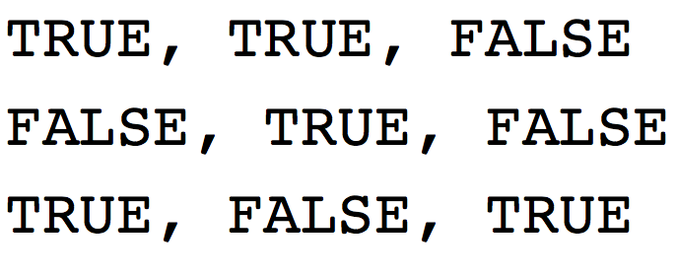
Matrix
Numeric Matrix
Logical Matrix

Slide 34
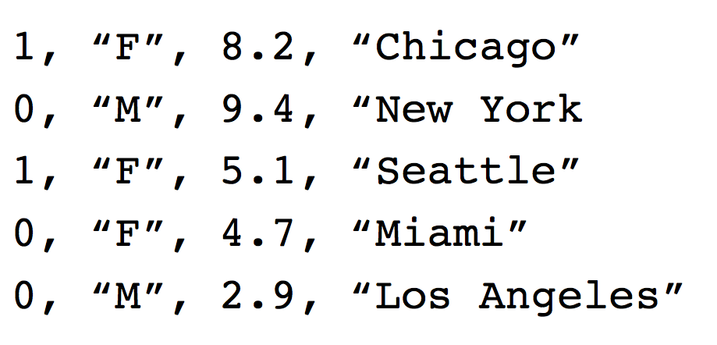
Data Frame

Slide 35
Object types
Object | Modes | More than one mode
Scalar | Logical, Char, Numeric | No
vector | Logical, Char, Numeric | No
Matrix | Logical, Char, Numeric | No
Data frame | Logical, Char, Numeric | Yes
Notes:
Format of data,
In what form is data stored

Slide 36
Creating objects
Assignment operator: <- or =
Objects need to be assigned a name otherwise they get dumped to the main window, not saved to the environment.
Notes:
Objects need to be assigned a name, otherwise they get dumped to main window, not saved to the environment

Slide 37
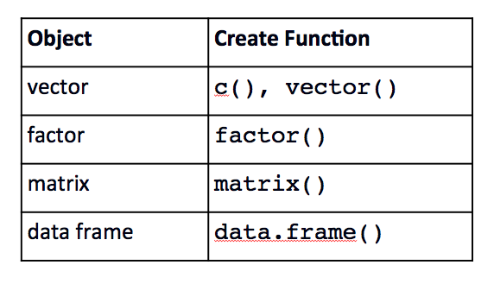
Creating objects

Slide 38
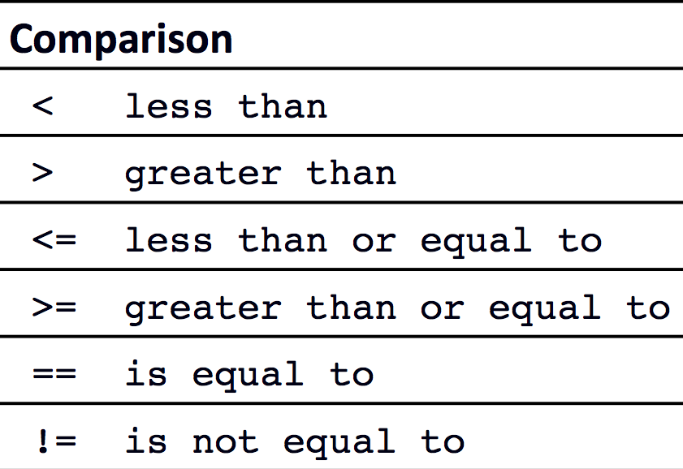
Other operators
Arithmetic: + - * / ^

Slide 39
Try the following examples
6 < 3
False
“hello” == “Hello”
False
“UW” == “UW”
True
There is a difference between = and ==

Slide 40
Manipulating Data
Viewing subsets of data using column names and operators:
mtcars[mtcars$vs == 1,]
mtcars[mtcars$cyl >= 6,]
mtcars$name[mtcars$hp > 100]
mean(mtcars$mpg[mtcars$cyl==4])
Notes:
We can view subsets of data using column names and operators

Slide 41
Creating a new variable
Wt.lb = mtcars$wt * 1000
mtcars = data.frame(mtcars,wt.lb)
Notes:
This creates a new vector called wt.lb of length 32 (our number of cases)
We can use wt.lb without adding it to our dataframe
But if you like it, you can add it to the existing dataframe.

Slide 42
Data analysis
Hypothesis Testing
t.test
Regression
lm(), glm()

Slide 43
Data analysis: linear regression
regr = lm(mpg ~ wt.lb + hp + cyl, data=mtcars)
The output of the regression is also an object. We’ve named it regr.
summary(regr)
class(regr)

Slide 44
Other R courses
Introduction to R Base Graphics
R Graphics Using ggplot2
Data Wrangling in R

